Slide 1
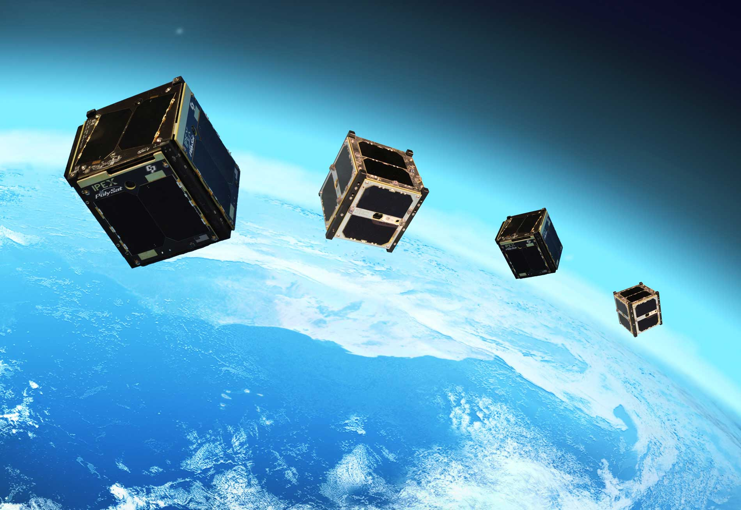
RL for LEO Satellite Momentum Stabilization
Anirudh Aatresh, Joseph Breeden, Kevin Tan, Liliang Wang

Slide 2
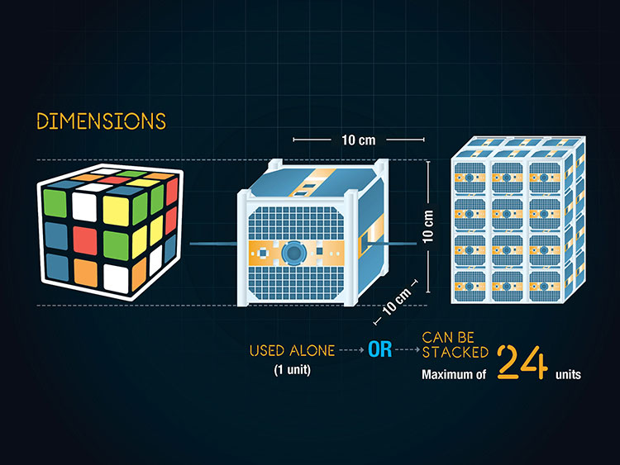
Introduction: The Problem
Space is not a vacuum, especially for satellites in Low Earth Orbits (LEO)
Disturbances include
Upper atmospheric drag, solar radiation pressure, gravity gradient, magnetic field interactions
These disturbances
Induce orbit decay
Rotate the satellites
Even worse for tiny CubeSats

Slide 3
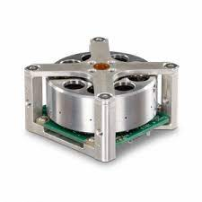
Countering the Problem
Onboard reaction wheels can be used to counter the rotation induced by the disturbances
Must be regularly unloaded to prevent saturation
Solution:
Use Earth’s magnetic field to provide an opposing torque while unloading stored momentum in the wheels
Existing control laws not robust to irregularities in the Earth’s magnetic field and CubeSat construction limitations
Use RL to create a new control law robust to these
Experiments will be based on a simulated environment developed by NASA called 42

Slide 4
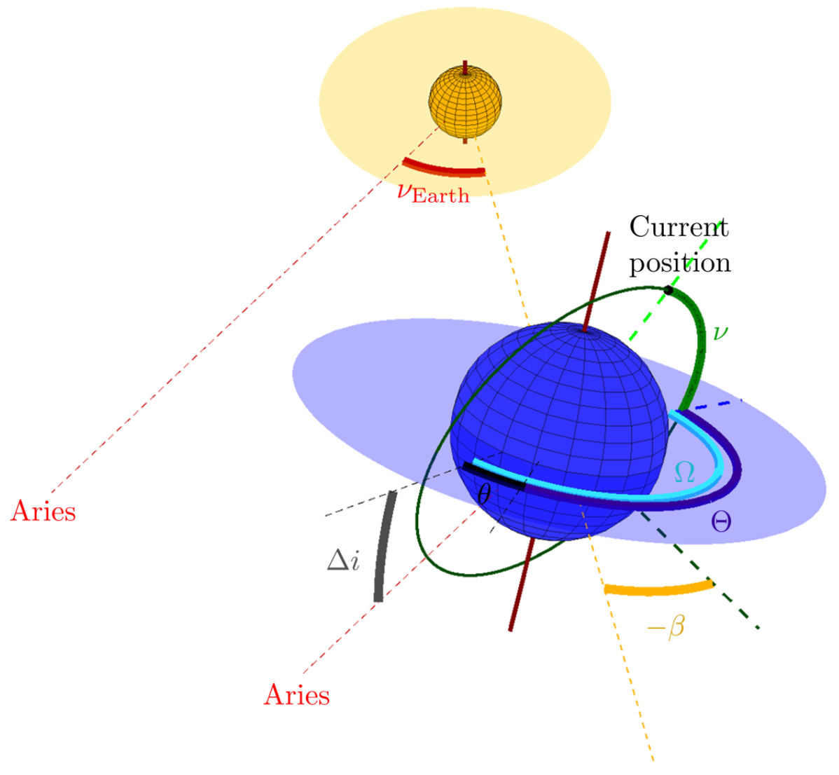

Mathematical Formulation
Let the CubeSat’s position be described by the angles $(ν,Θ,β)$ relative to the positions of the Earth and the Sun
$ν$ is the position of the satellite in the orbit
$Ω$ is the precession of the orbit
$β$ is the angle between the local Sun vector and the normal vector to the orbital place
$Θ :=Ω−θ$, where $θ$ is the current rotation of the Earth in the day

Slide 5
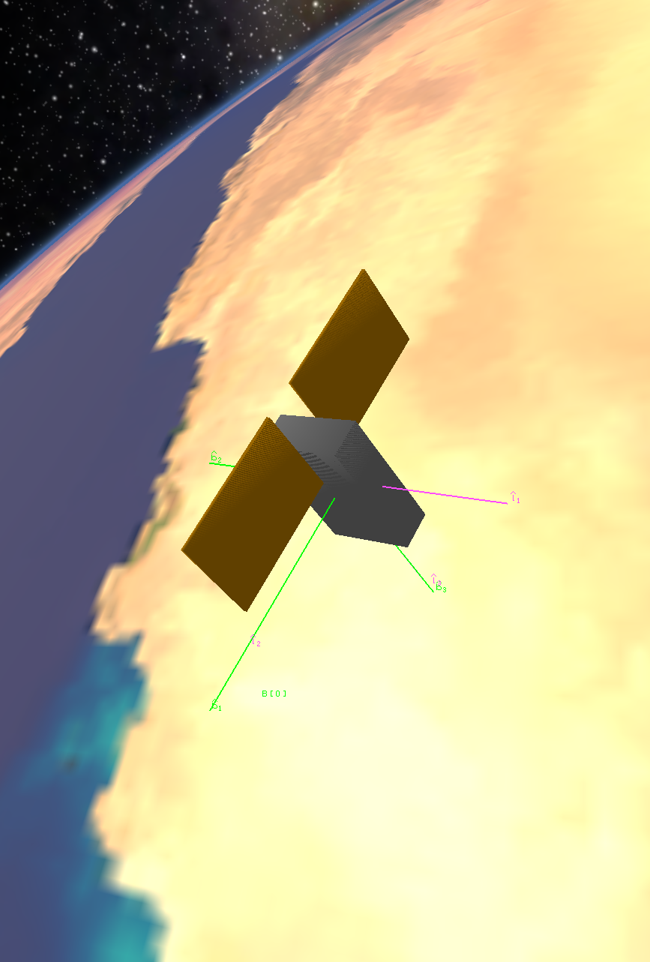
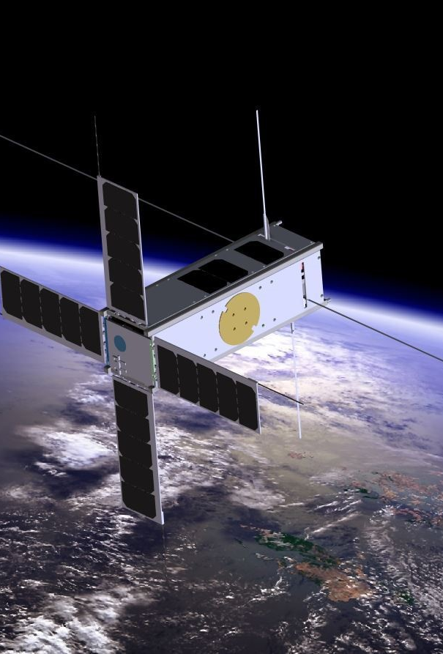
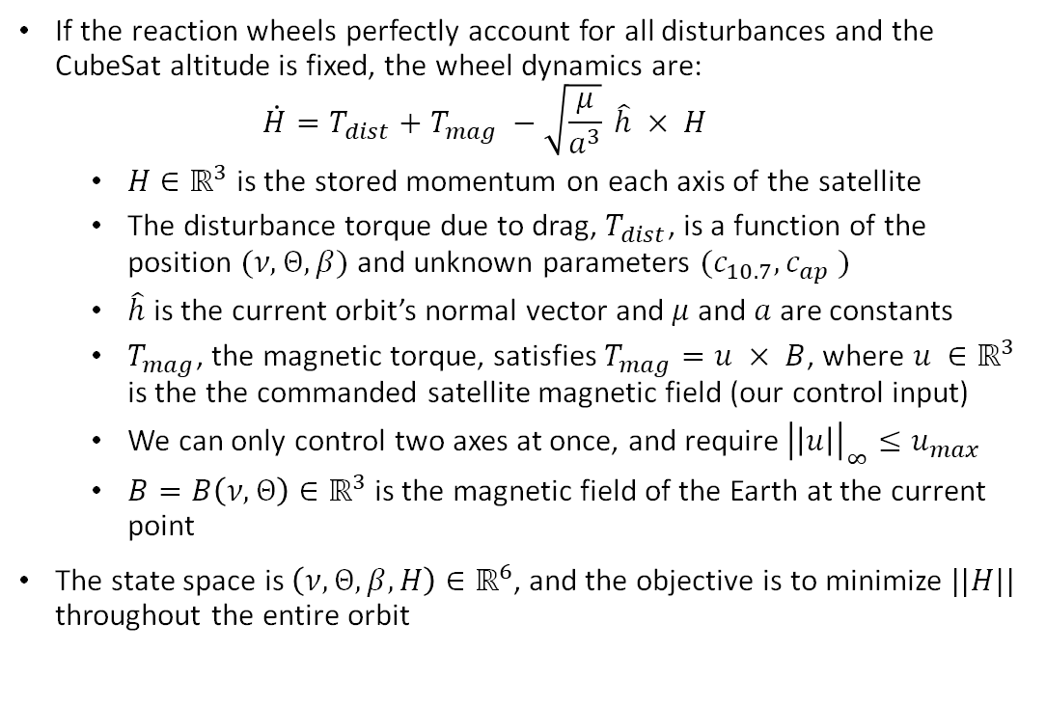
State Space, Control, Dynamics
If the reaction wheels perfectly account for all disturbances and the CubeSat altitude is fixed, the wheel dynamics are:
$$\dot{H}=T_{dist}+T_{mag} −\sqrt{\frac{μ}{a^{3}}} \hat{h} × H$$
$H∈ℝ^{3}$ is the stored momentum on each axis of the satellite
The disturbance torque due to drag, $T_{dist}$, is a function of the position $(ν,Θ,β)$ and unknown parameters $(c_{10.7}, c_{ap} )$
$\hat{h}$ is the current orbit’s normal vector and $μ$ and $a$ are constants
$T_{mag}$, the magnetic torque, satisfies $T_{mag}=u × B$, where $u ∈ℝ^{3}$ is the the commanded satellite magnetic field (our control input)
We can only control two axes at once, and require ${\left|\left|u\right|\right|}_{∞}≤u_{max}$
$B=B\left(ν, Θ\right)∈ℝ^{3}$ is the magnetic field of the Earth at the current point
The state space is $\left(ν,Θ,β, H\right)∈ℝ^{6}$, and the objective is to minimize $||H||$ throughout the entire orbit

Slide 6
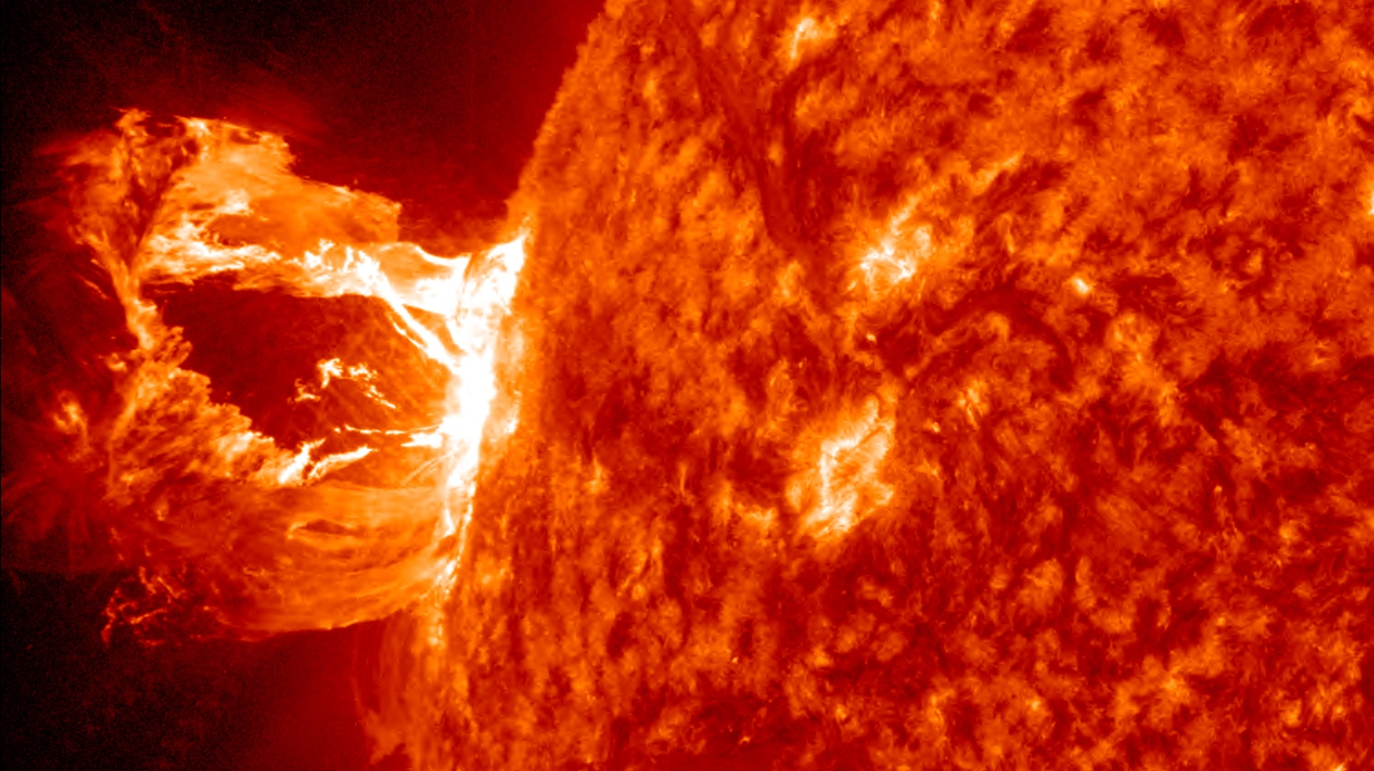

Satellite Disturbances
The atmosphere changes slowly but in unpredictable ways
$c_{10.7}$= measure of current solar activity
$c_{ap}$= measure of current geomagnetic activity
High activity → denser atmosphere → more disturbances
These indices are frequently measured in daily/hourly timescales
Result: disturbances are not random on short time-scales
Question: what are the best choices of $(c_{10.7}, c_{ap} )$ to train and evaluate the policies?

Slide 7
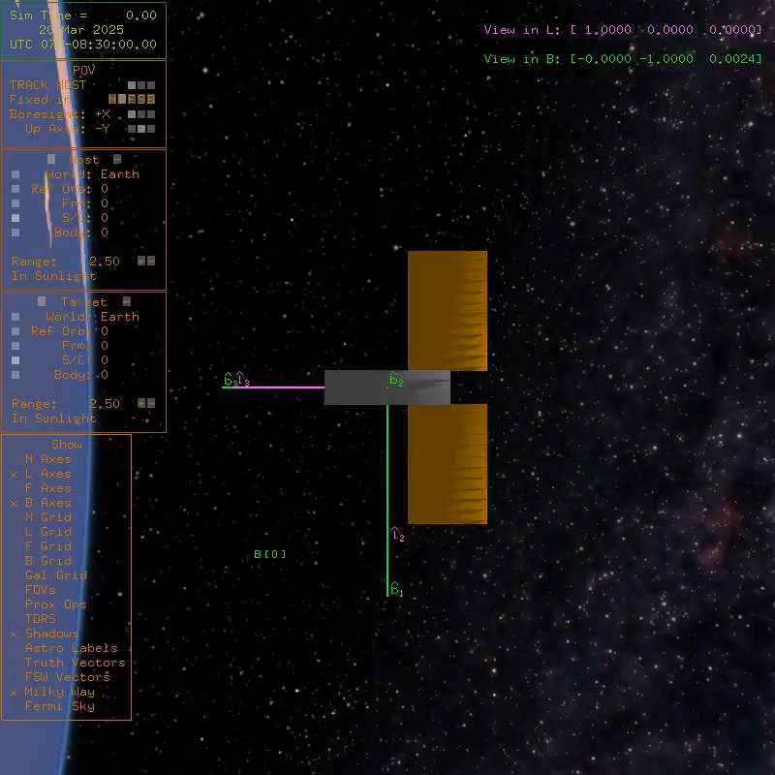

One Orbit
CubeSat orientation is fixed
Simulates mid-fidelity disturbance models with specified $(c_{10.7}, c_{ap} )$

Slide 8
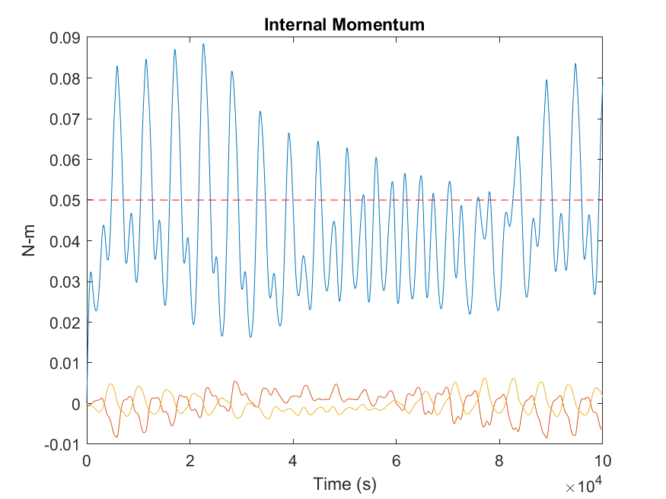

Method
Linear control laws are inefficient due to the complexity of the Earth’s magnetic field
Baseline algorithm requires unrealistically large momentum storage capacity
We use actor-critic based algorithms to train a controller to choose a series of actions to drive the angular momentum of the wheels close to zero:
$$\min_{u∈ℝ^{3}}|\left|H\right||$$
Successfully transfer the momenta of the reaction wheels to the Earth through magnetic actuators interacting with the Earth’s magnetic field

Slide 9
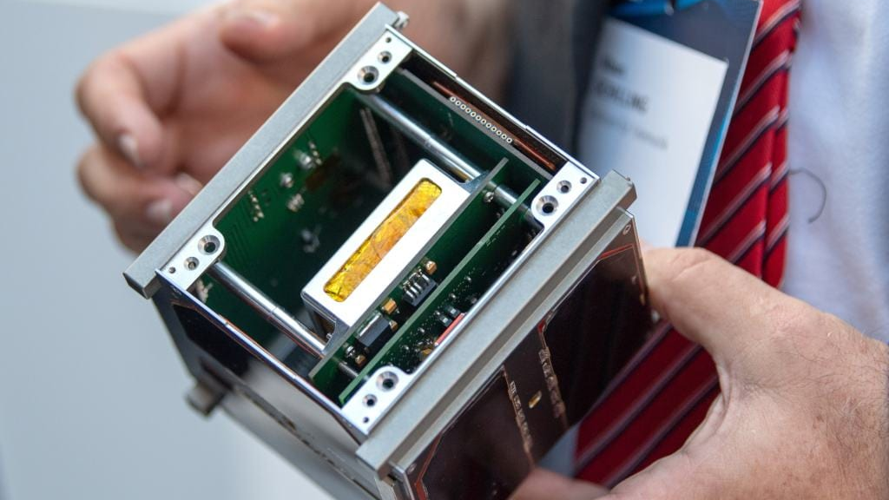
Online or Offline?
We look towards solving this problem offline
Leaves open the possibility of learning a policy on real satellite data in the future, not just data from 42
Allows for offline pre-training, allowing for more effective policies when combined with online policy improvement
Learning a policy online from scratch in the context of a real satellite will be dangerous and costly
Data will be collected from 42 from two behavior policies
Stochastic policy
Decent baseline policy

Slide 10
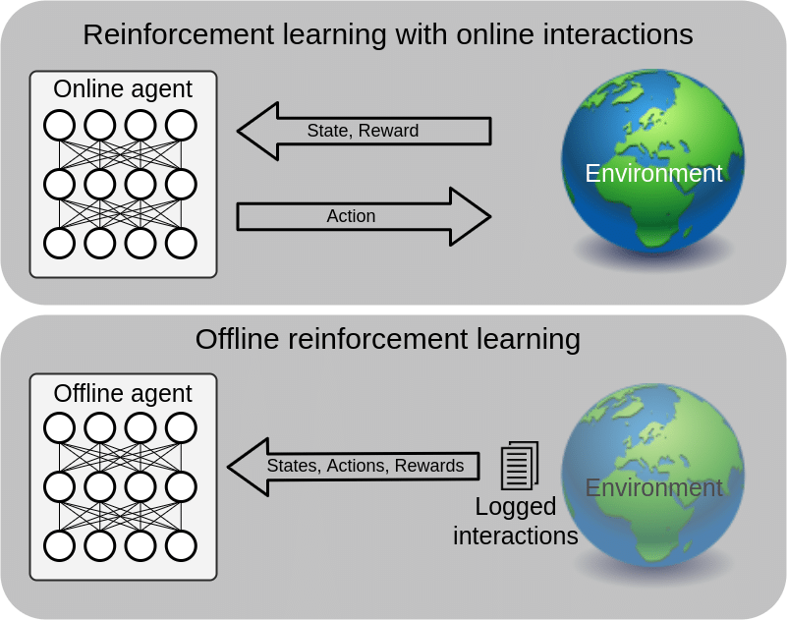
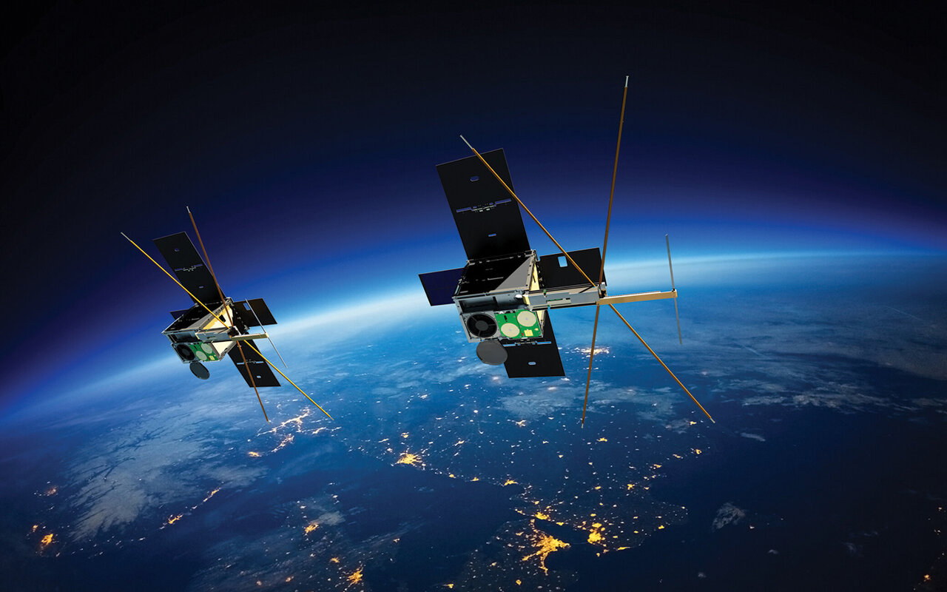
Offline RL
Online RL
Get state, take action, observe next state
Learning by doing
Off-policy RL
Get state, take action based on behavior policy, observe next state
Update new policy in the background
Offline RL
Observe a dataset of states, actions, rewards collected by a behavior policy
Learning by watching someone else do the doing

Slide 11

d3rlpy: An Offline Deep RL Library
Offline reinforcement learning library
State-of-the-art algorithms
Scikit-learn style API

Slide 12
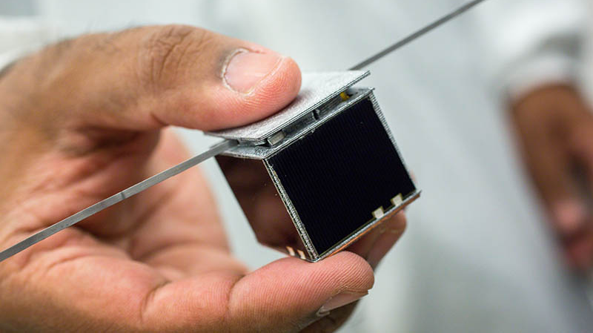
Algorithms we Tried
Learning
Conservative Q-Learning (CQL)
Promising algorithm performing offline soft actor-critic computation with a modified Q-function estimator
Tackles the common problem of overestimating the Q-value in offline RL
TD3 + BC
TD3, but imposing a penalty on actions different from the behavior policy
Conservative Offline Model-Based Policy Optimization (COMBO)
Fit a probabilistic dynamics model on observed data and generate synthetic data
Train on synthetic data with regularization on out-of-sample state-action tuples
Off-Policy Evaluation
Fitted Q-Evaluation
Fit a Q-function with mean-square TD error loss on the collected dataset

Slide 13
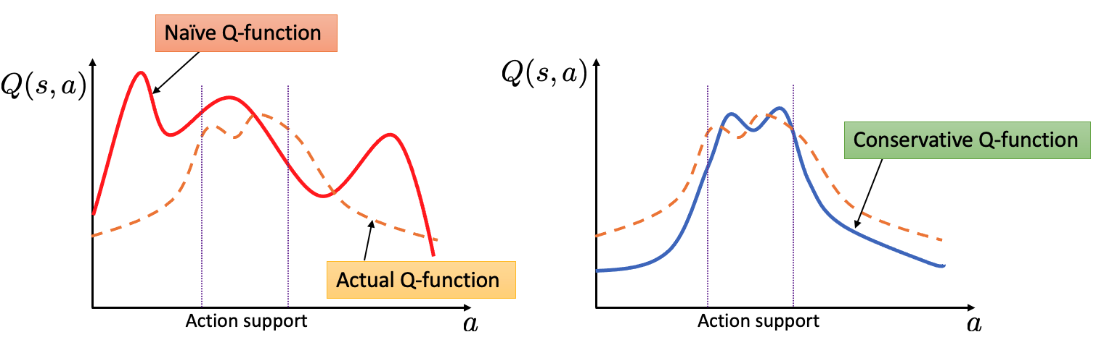
Conservative Q-Learning
Applicable to continuous state-action control problem
Suitable for complex and multi-modal data distribution
Addresses the common issue of standard offline RL algorithms:
Overestimation of value function

Slide 14
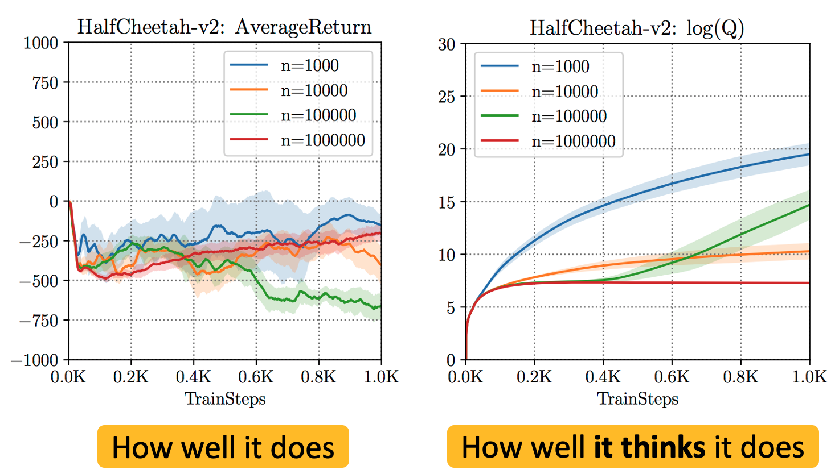
Conservative Q-learning for Offline RL
Motivation:
Overestimation induced by:
Distributional shift between the behavior policy and the learned policy
Function approximation error
Solution:
Learn conservative, lower-bound estimates of the value function by
regularizing the Q-values during training

Slide 15
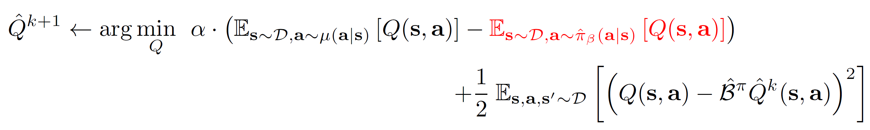
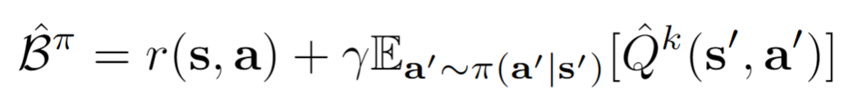
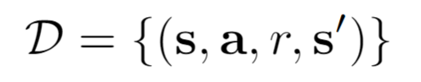
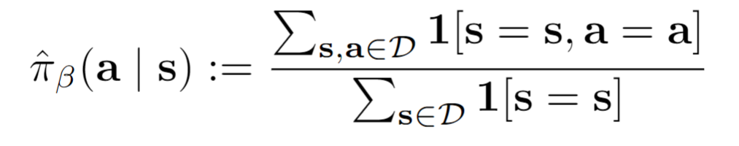
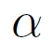
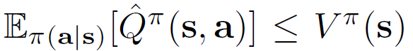
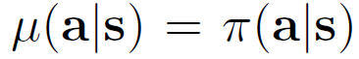
Conservative Q-learning for Offline RL
Conservative off-policy evaluation
Where,
Operator:
given a dataset
Empirical control policy:
Tradeoff factor:
Theorem: when

Slide 16
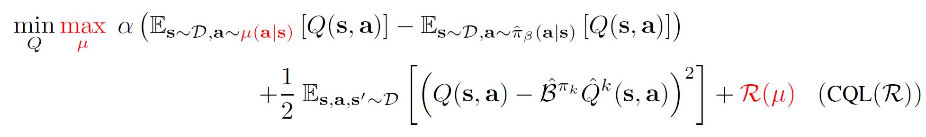
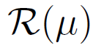
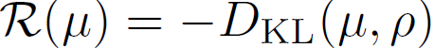
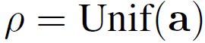
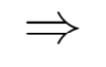
Conservative Q-learning for Offline RL
Conservative Q-learning
: regularizer, and

Slide 17
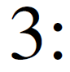
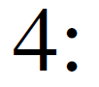
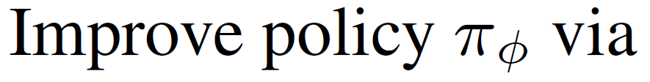
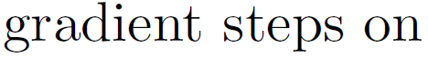
Conservative Q-learning for Offline RL
Algorithm

Slide 18
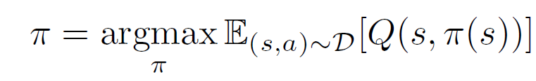
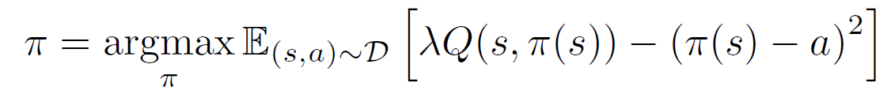
TD3+ BC (Behavior Cloning)
TD3's policy is updated with the deterministic policy gradient:
TD3+BC: add a behavior cloning term to regularize the policy:

Slide 19
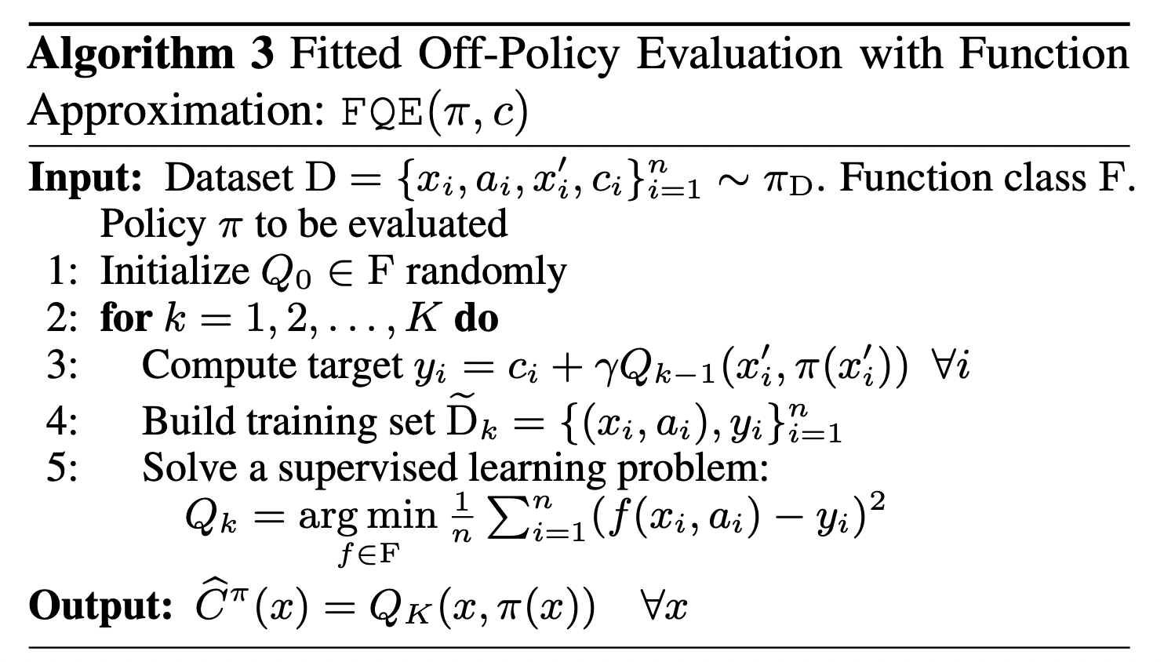
Fitted-Q Evaluation

Slide 20
Preliminary Experiments: Small Dataset
 | FQE
 | Evaluation on data generated through stochastic policy | Evaluation on data generated through deterministic policy
CQL trained on data collected using the stochastic policy | -1.046 | -1.3
CQL trained on data collected using the deterministic policy | -1.263 | -1.658
TD3+BC trained on data collected using the stochastic policy | -1.067 | -0.826
TD3+BC trained on data collected using the deterministic policy | -1.751 | -1.724
COMBO trained on data collected using the stochastic policy | -1.687 | -1.453
COMBO trained on data collected using the deterministic policy | -2.243 | -1.104
Four orbits of training data
Four orbits used for evaluation via FQE
Deterministic baseline: -4.1
Stochastic baseline: -5.63

Slide 21

Hyperparameter Tuning
Hyper-parameters are those quantities that are set or initialized prior to training and aid in learning the parameters of the model in focus.
These quantities are not fit during training
The hyper-parameters that we varied in our initial experiments are:
Learning rate of actor
Learning rate of critic
Learning rate of temperature (for CQL)
Number of steps in TD calculation
Discount factor.
Trained on a small dataset for 100 epochs and evaluated over 100 epochs.

Slide 22
Hyperparameter Tuning
 | Hyper parameters |  |  |  |  | FQE
 | Learning rate of actor | Learning rate of critic | Learning rate of temperature parameter (CQL only) | Number of steps in TD Calculation | Discount factor | Evaluation on data generated through stochastic policy | Evaluation on data generated through deterministic policy
CQL trained on data collected using the stochastic policy | 1.00E-05 | 3.00E-04 | 1.00E-04 | 1 | 0.99 | -1.046 | -1.3
 | 1.00E-05 | 3.00E-04 | 1.00E-04 | 3 | 0.99 | -0.788 | -1.178
 | 1.00E-04 | 3.00E-04 | 1.00E-04 | 3 | 0.99 | -0.991 | -1.321
CQL trained on data collected using the deterministic policy | 1.00E-05 | 3.00E-04 | 1.00E-04 | 1 | 0.99 | -1.263 | -1.658
 | 1.00E-05 | 3.00E-04 | 1.00E-04 | 3 | 0.99 | -1.333 | -1.404
 | 1.00E-05 | 3.00E-04 | 1.00E-04 | 5 | 0.99 | -1.105 | -1.171
TD3+BC trained on data collected using the stochastic policy | 1.00E-05 | 3.00E-04 | - | 1 | 0.99 | -1.067 | -0.826
 | 3.00E-05 | 3.00E-04 | - | 1 | 0.99 | 0.708 | -2.948
 | 1.00E-05 | 3.00E-04 | - | 3 | 0.99 | -1.371 | -0.887
TD3+BC trained on data collected using the deterministic policy | 1.00E-05 | 3.00E-04 | - | 1 | 0.99 | -1.751 | -1.724
 | 3.00E-05 | 3.00E-04 | - | 1 | 0.99 | -1.522 | -1.742
 | 1.00E-05 | 3.00E-04 | - | 3 | 0.99 | 0 | 0

Slide 23
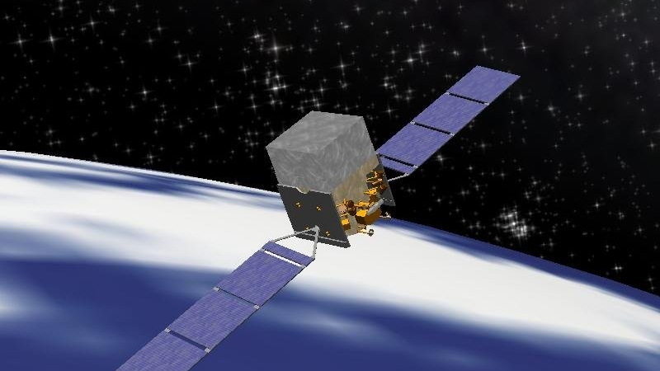
Moving it to 42: Evaluating Policies Online
Pipeline
Run 42 several times to generate training data
Import data into d3rlpy
Run various training algorithms
Export neural net policy
Import neural net policy into C++ program using torchscript (beta)
Evaluate new policy in 42
Notes:
Writing that C++ program took a very long time

Slide 24
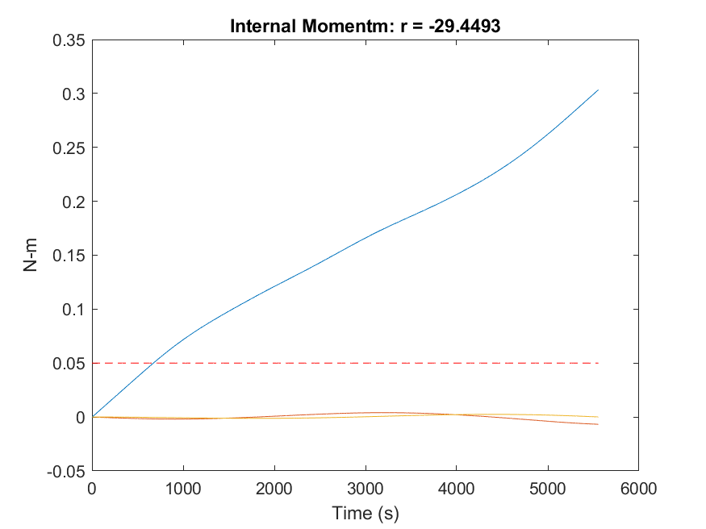
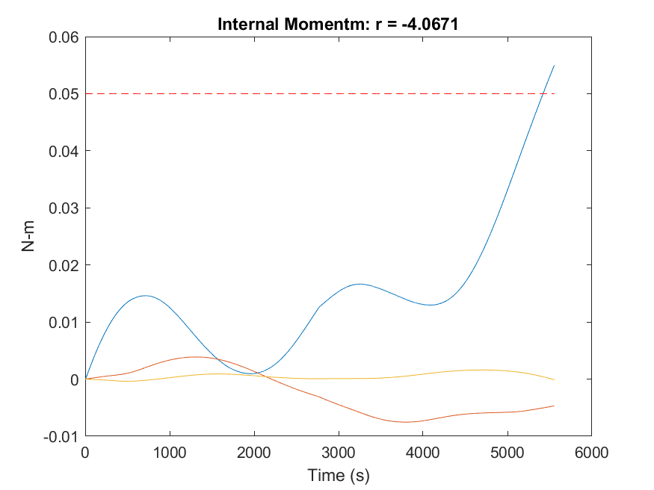
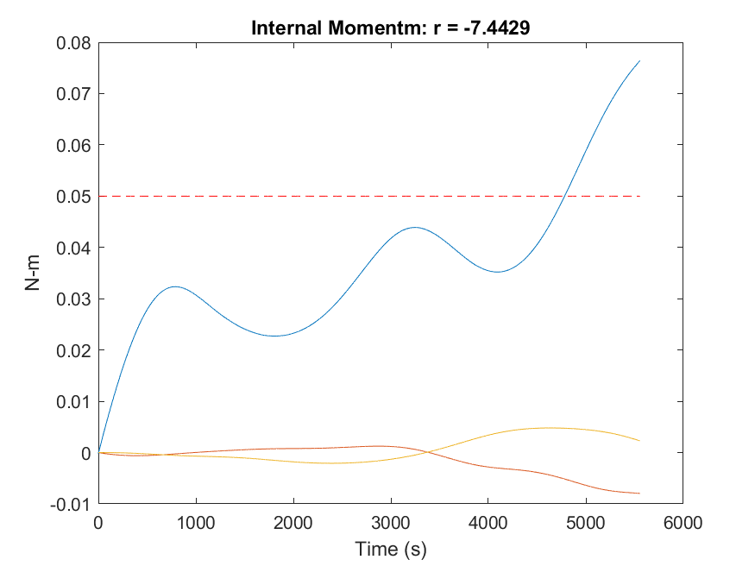
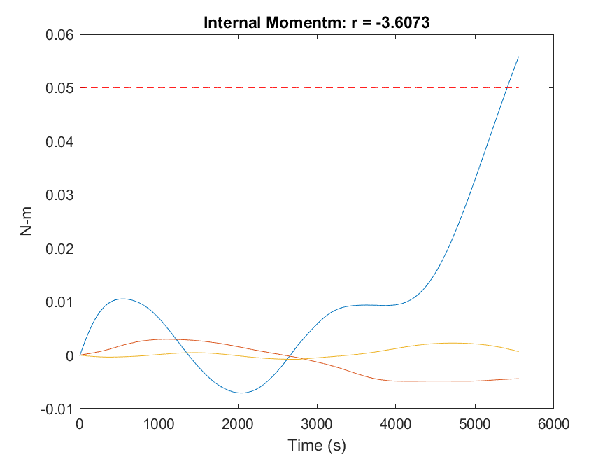
Policy Performance
No Control Input
CQL – PID Training Data
Nominal Case:
F10.7 index = 180,
AP index = 70 (same as prior plot)
100 chunks
PID Control Input
CQL – Stochastic Training Data

Slide 25
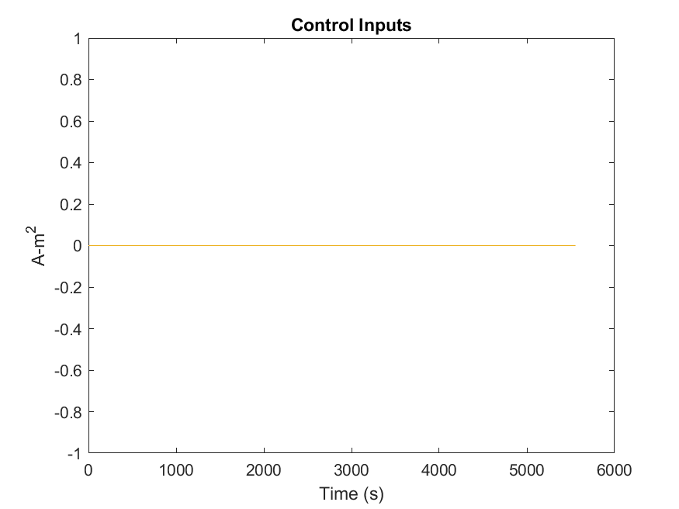
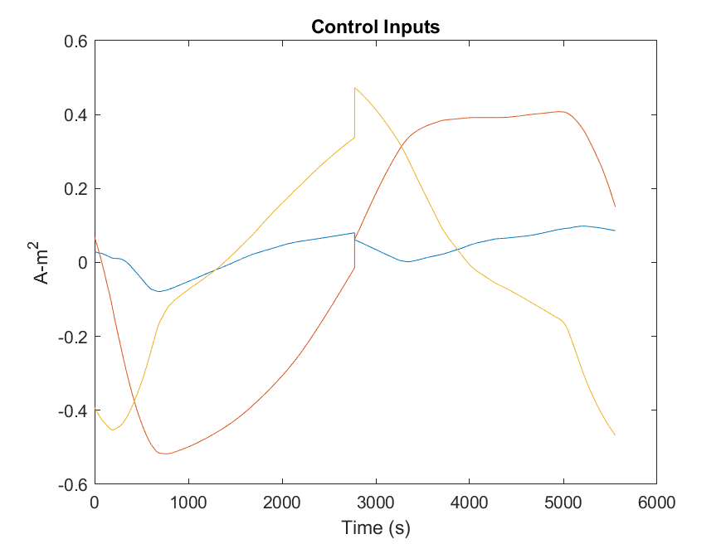
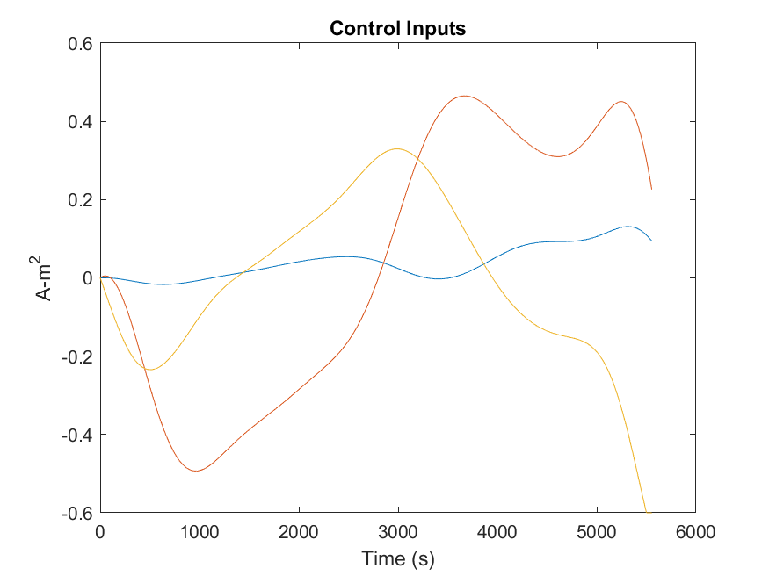
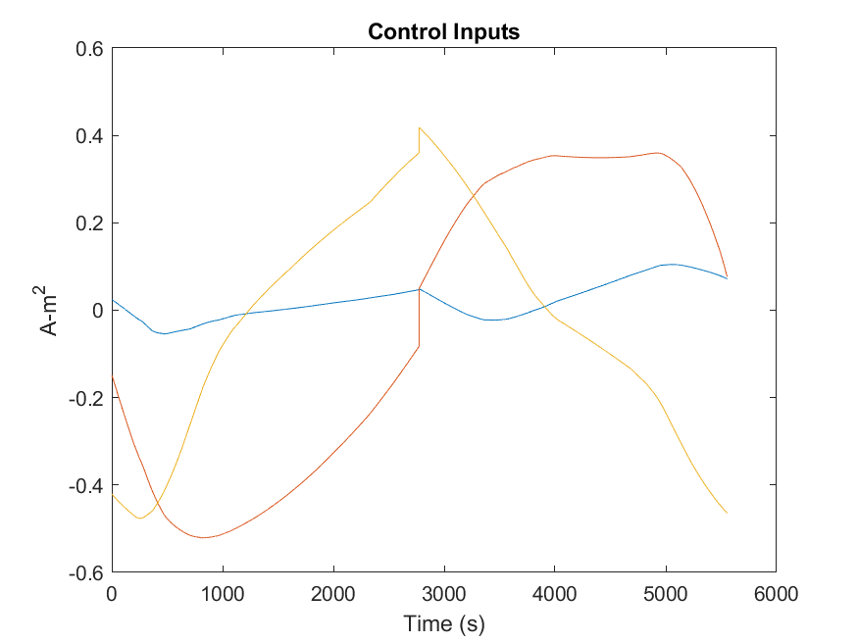
Policy Control Inputs
No Control Input
CQL – PID Training Data
Nominal Case:
F10.7 index = 180,
AP index = 70
100 chunks
PID Control Input
CQL – Stochastic Training Data

Slide 26
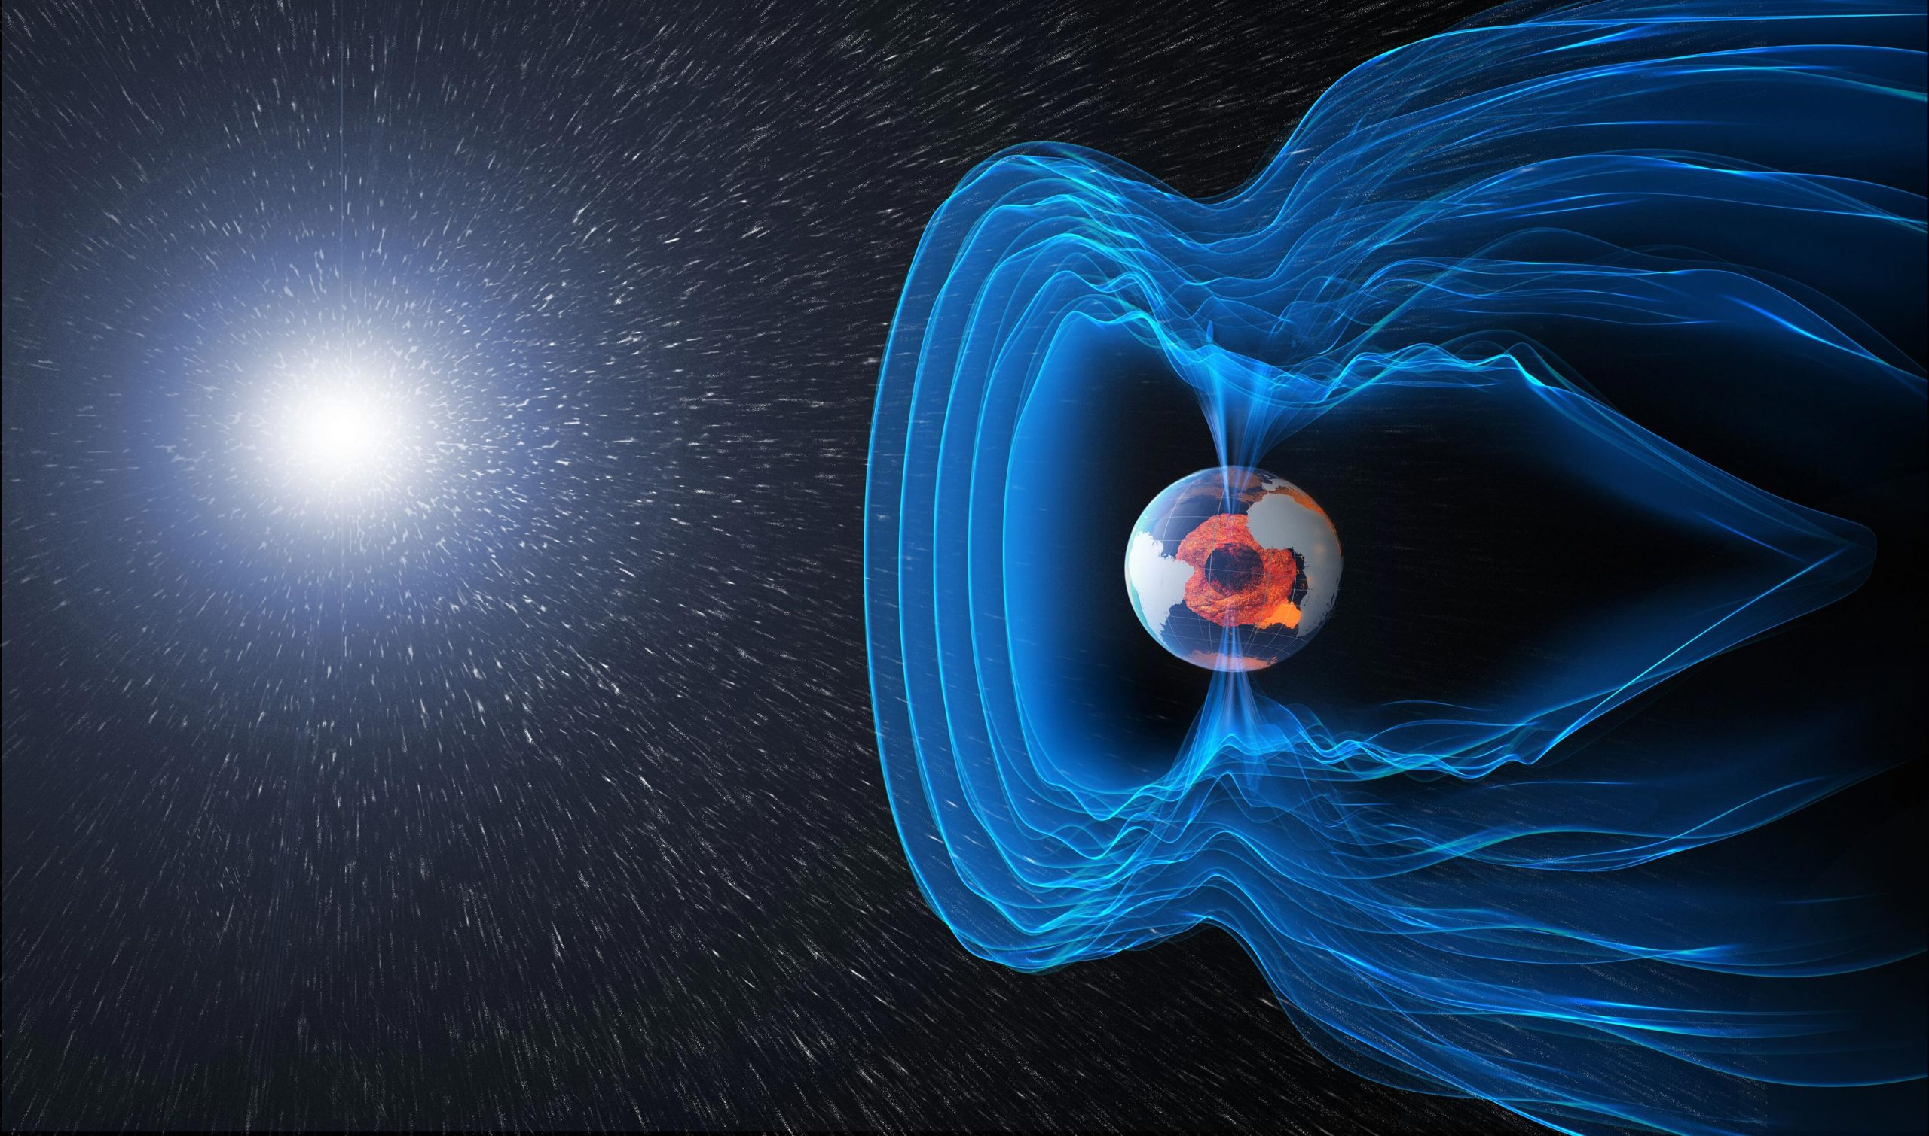
Conclusions – Nominal Environment
RL does not prevent divergence, but decreases average system momentum
RL uses similar control inputs even when trained with purely stochastic data
How much data is necessary?
Somewhere between 4 and 100 “chunks”
Performed better than PID even with a PID behavior policy
Control inputs do not saturate, which means additional control authority is available

Slide 27
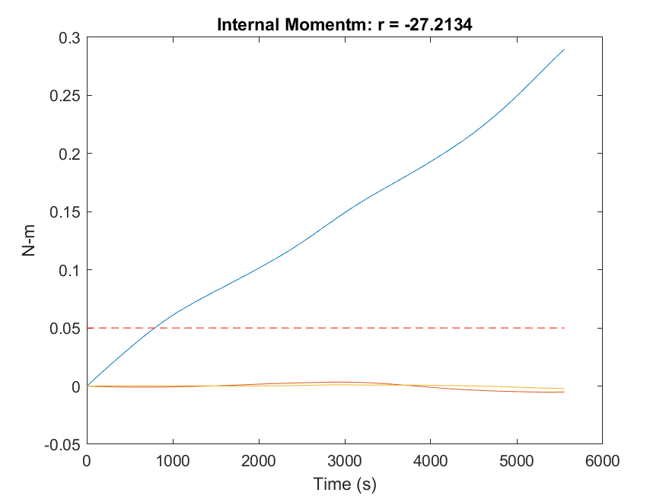
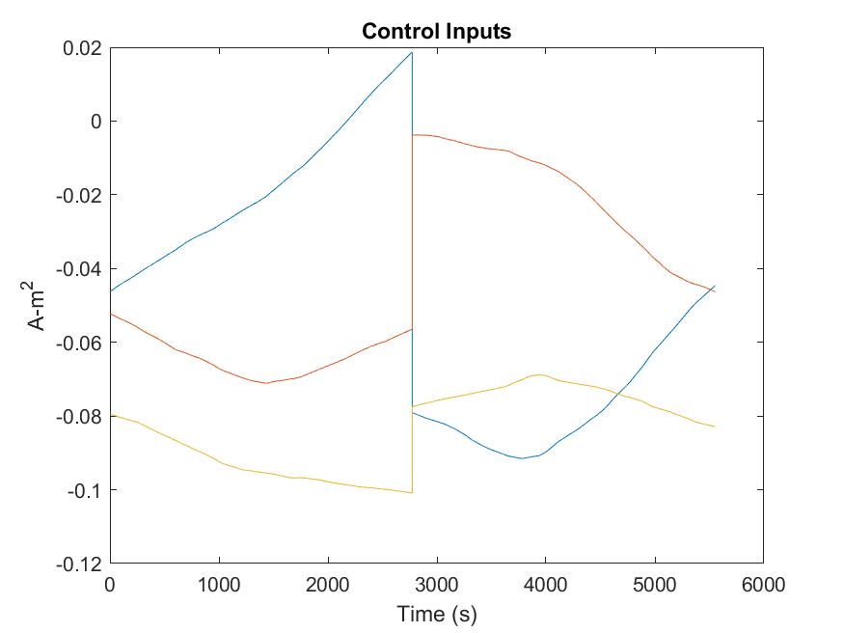
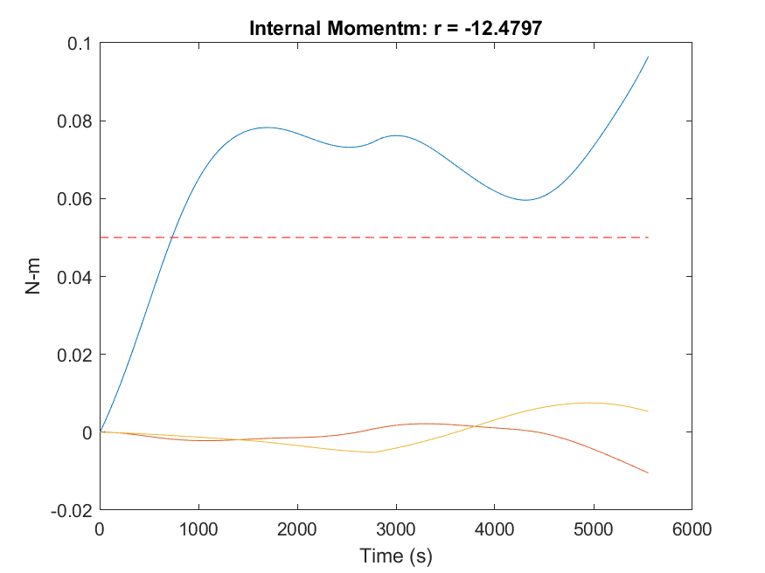
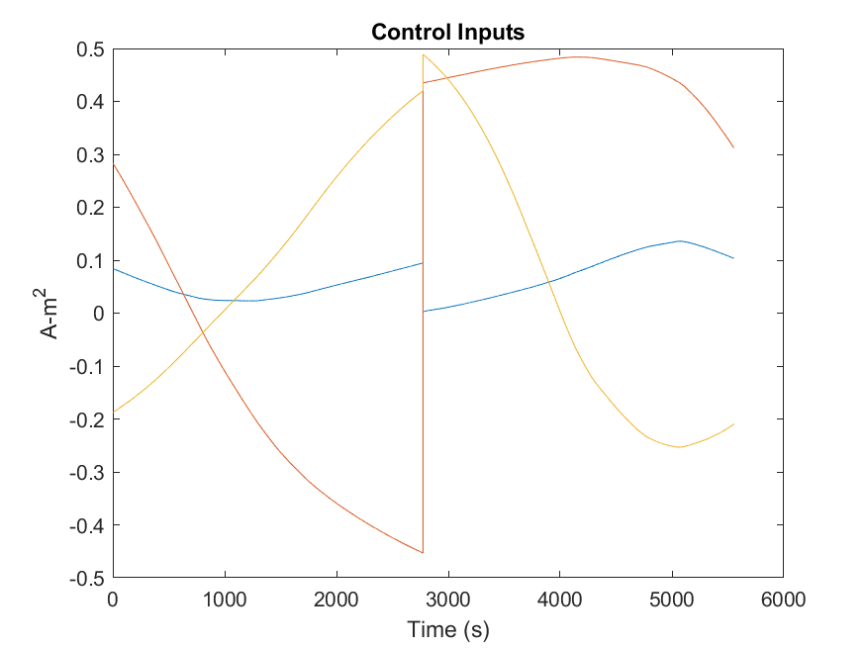
Training on Smaller Dataset
CQL – PID Training Data
Only 4 chunks
Results likely heavily dependent on what disturbances were observed during these chunks
CQL – Stochastic Training Data

Slide 28
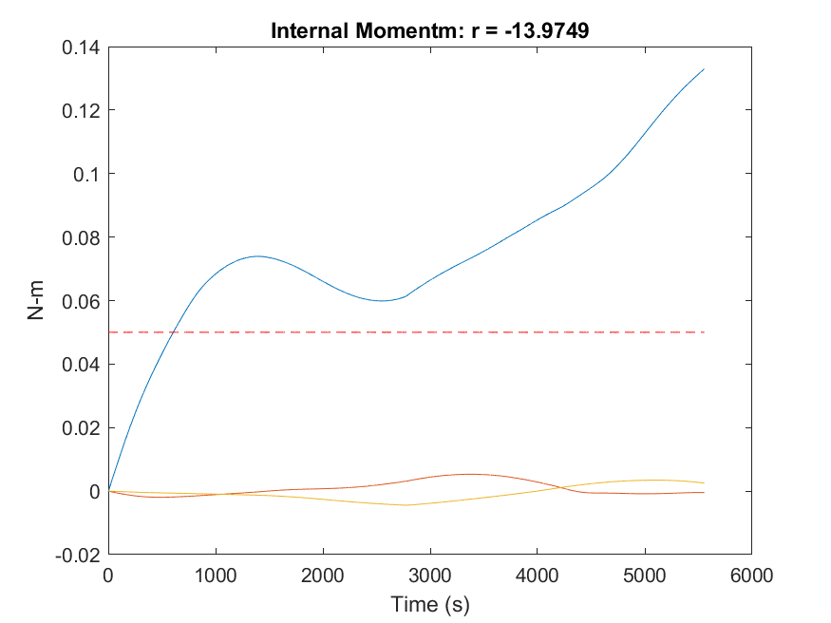



Training on Smaller Dataset
TD3+BC – PID Training Data
Need more chunks to give a good evaluation of these methods
TD3+BC – Stochastic Training Data

Slide 29


Training on Smaller Dataset
Need more chunks to give a good evaluation of these methods
COMBO – Stochastic Training Data

Slide 30




Policy Performance for Off-Nominal Environment
No Control Input
CQL – PID Training Data
Strong Disturbance:
F10.7 index = 230,
AP index = 100
100 chunks
This case is at the edge of the training set
PID Control Input
CQL – Stochastic Training Data

Slide 31




Policy Performance for Off-Nominal Environment
No Control Input
CQL – PID Training Data
Weak Disturbance:
F10.7 index = 140,
AP index = 40
100 chunks
RL controllers are too aggressive
PID Control Input
CQL – Stochastic Training Data

Slide 32




Policy Performance for Off-Nominal Environment
No Control Input
CQL – PID Training Data
Weak Disturbance:
F10.7 index = 140,
AP index = 40
100 chunks
RL controllers are too aggressive
PID Control Input
CQL – Stochastic Training Data

Slide 33




Long Term Policy Performance
No Control Input
CQL – PID Training Data
Nominal case
RL control laws are not effective outside of the training set (first 5500 seconds)
CQL – Stochastic Training Data
PID Control Input

Slide 34

Comparison to Fitted Q Evaluation
Consider CQL algorithm trained with PID behavior policy
PID total reward = -7.5
FQE based on training = –1.38
Real reward in 42 = –4.0
FQE is optimistic
This is not entirely fair because of the way disturbances are introduced

Slide 35


Training Improvements
Less frequent state sampling (e.g. every 2 seconds)
Avoid data overload!
Vary the disturbance level $(c_{10.7}, c_{ap} )$ throughout an orbit
Not realistic but may yield more stable training results
Cover wider state space area, including diverging states
Train with new hyperparameters
Different neural network structures
Current neural net was very simple (2 layers, 256 elements)

Slide 36


Limitation
Unknown parameters
$c_{10.7}$= measure of current solar activity
$c_{ap}$= measure of current geomagnetic activity
High activity → denser atmosphere → more disturbances
These indices are frequently measured in daily/hourly timescales
Result: disturbances are not random on short time-scales
Fixed at the start of each episode
Global confounder! We’re dealing with offline confounded RL

Slide 37

Steps Moving Forward
Generate training data for multiple orbits (i.e. all state angles)
Test different algorithms
Use improved hyperparameters
Determine required data quantity

Slide 38
Questions
Comments

